Slide 1
What is Feature Engineering?

Slide 2
Feature Engineering is the process of choosing, creating, or modifying input variables (features) so that machine learning models can better understand patterns in the data.
It means converting raw data into useful and meaningful information that helps improve the model’s accuracy and overall performance.

Slide 3
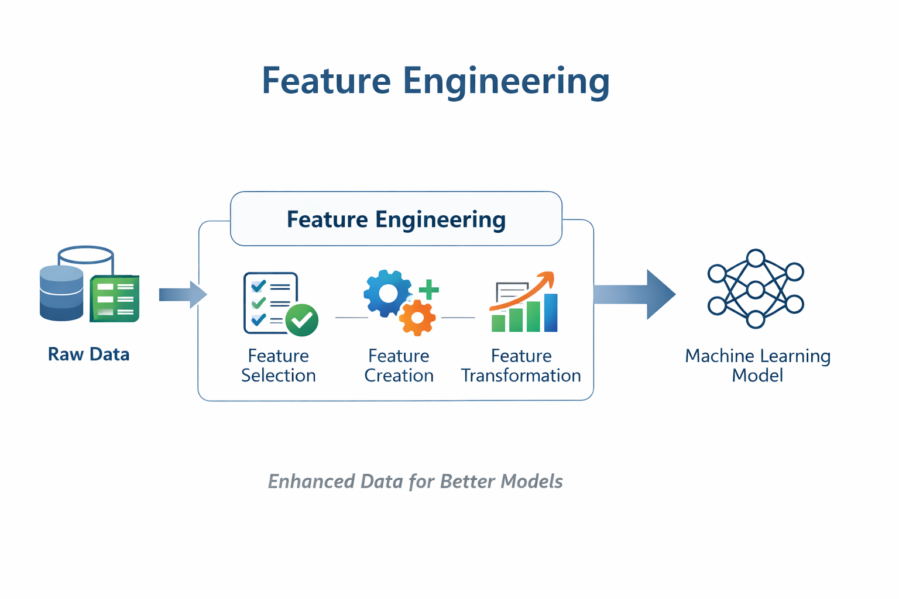

Slide 4
This step can involve filling or removing missing values, converting categorical data into numerical form, scaling or normalizing numbers, creating new features, or combining existing ones. It helps transform raw, unorganized real-world data into a clean and structured format that machine learning models can easily understand and use to make more accurate predictions.
Importance of Feature Engineering
Feature engineering plays a major role in improving the performance of machine learning models. By carefully selecting and refining features, we can:
Improve accuracy: Choosing meaningful and relevant features helps the model understand patterns better, resulting in more accurate predictions.
Reduce overfitting: Using only important features prevents the model from memorizing noise in the data, allowing it to perform well on unseen data.
Increase interpretability: Well-designed features make it easier to understand how the model arrives at its predictions.
Enhance efficiency: Working with fewer, high-quality features reduces training time and improves prediction speed, saving both time and computational resources.

Slide 5
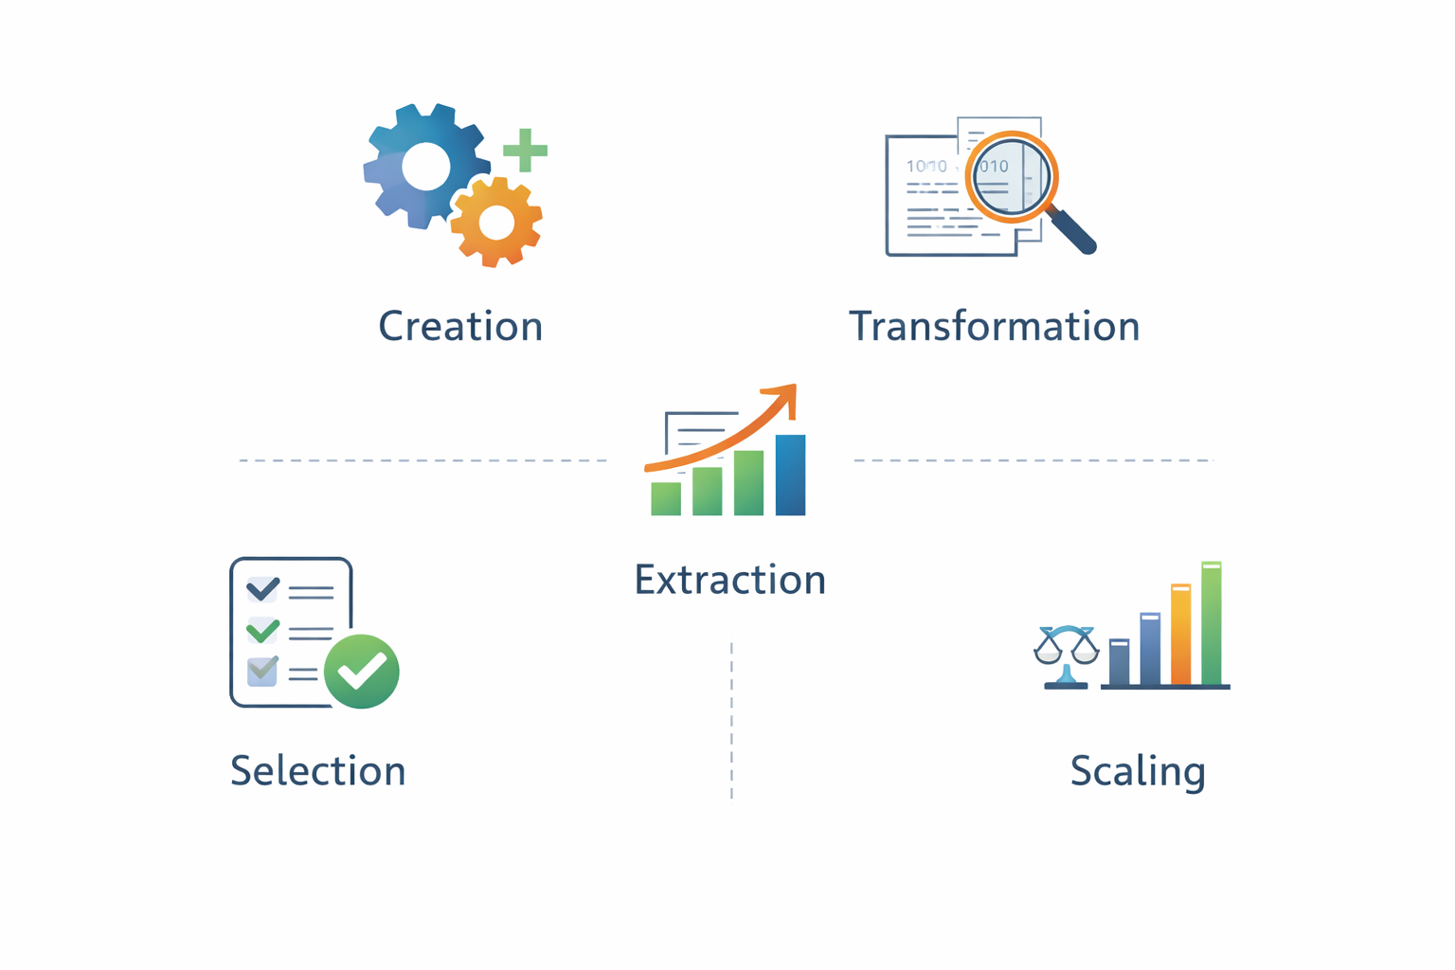

Slide 6
1. Feature Creation: Feature creation is the process of generating new features using domain knowledge or by identifying patterns within the data. It can be:
Domain-specific: Features created based on industry expertise or business rules.
Data-driven: Features developed by analyzing patterns and relationships in the data.
Synthetic: Features formed by combining or transforming existing features.
2. Feature Transformation: Feature transformation modifies existing features to help the model learn more effectively. It includes:
Normalization & Scaling: Adjusting the range of numerical features so they are consistent and comparable.
Encoding: Converting categorical variables into numerical format (for example, one-hot encoding).
Mathematical Transformations: Applying operations like logarithmic transformation to handle skewed data and improve distribution.

Slide 7
3. Feature Extraction: Feature extraction focuses on deriving the most meaningful information from data, often reducing the number of features while improving model performance. It includes:
Dimensionality Reduction: Methods like Principal Component Analysis (PCA) reduce the number of features while retaining the most important information.
Aggregation & Combination: Combining features by summing, averaging, or grouping them to simplify the data and make the model more efficient.
4. Feature Selection: Feature selection is the process of choosing the most relevant features from the dataset to improve model performance and reduce complexity. It includes:
Filter Methods: Select features based on statistical techniques such as correlation, chi-square test, or variance threshold.
Wrapper Methods: Choose features by evaluating different combinations based on model performance.
Embedded Methods: Perform feature selection as part of the model training process (for example, Lasso regression).

Slide 8
5. Feature Scaling: Feature scaling adjusts the range of numerical features so that all variables contribute equally to the model and no single feature dominates due to its larger scale. It includes:
Min-Max Scaling: Rescales feature values to a fixed range, usually between 0 and 1.
Standard Scaling (Standardization): Transforms features so they have a mean of 0 and a standard deviation of 1.

Slide 9
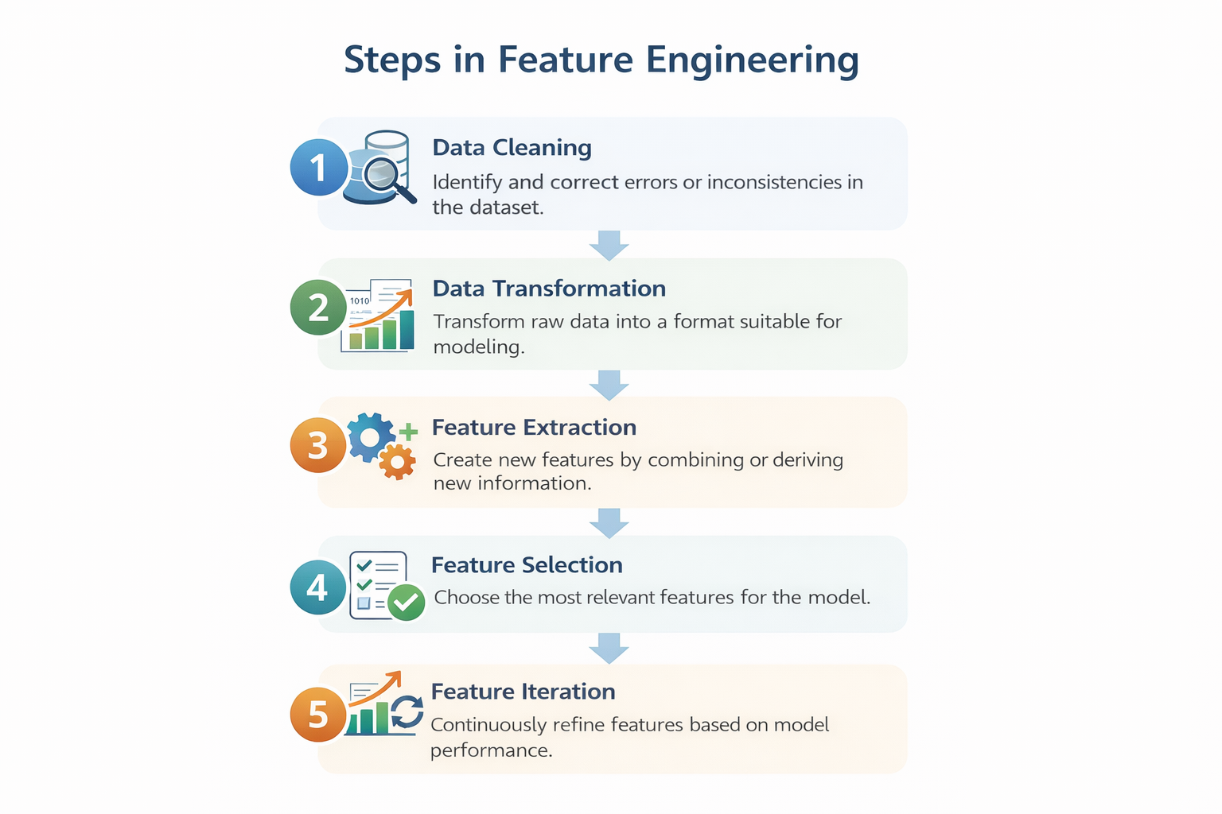

Slide 10
Steps in Feature Engineering
Feature engineering may differ based on the problem, but the overall process usually includes the following steps:
Data Cleaning: Detect and fix errors, missing values, or inconsistencies in the dataset to maintain accuracy and reliability.
Data Transformation: Convert raw data into a model-ready format using techniques such as scaling, normalization, and encoding.
Feature Extraction: Generate new features by combining or deriving information from existing variables to make the data more meaningful for the model.
Feature Selection: Identify and select the most important features using methods like correlation analysis, mutual information, or stepwise regression.
Feature Iteration: Continuously improve features based on model performance by adding, removing, or adjusting them to achieve better results.

Slide 11
Common Techniques in Feature Engineering
1. One-Hot Encoding: One-Hot Encoding converts categorical variables into binary indicators, allowing them to be used by machine learning models
import pandas as pd
data = {'Color': ['Red', 'Blue', 'Green', 'Blue']}
df = pd.DataFrame(data)
df_encoded = pd.get_dummies(df, columns=['Color'], prefix='Color')
print(df_encoded)
Output
Color_Blue Color_Green Color_Red
0 False False True
1 True False False
2 False True False
3 True False False

Slide 12
2. Binning: Binning transforms continuous variables into discrete bins, making them categorical for easier analysis.
import pandas as pd
data = {'Age': [23, 45, 18, 34, 67, 50, 21]}
df = pd.DataFrame(data)
bins = [0, 20, 40, 60, 100]
labels = ['0-20', '21-40', '41-60', '61+']
df['Age_Group'] = pd.cut(df['Age'], bins=bins, labels=labels, right=False)
print(df)
Age Age_Group
0 23 21-40
1 45 41-60
2 18 0-20
3 34 21-40
4 67 61+
5 50 41-60
6 21 21-40
Output

Slide 13
3. Text Data Preprocessing: Involves removing stop-words, stemming and vectorizing text data to prepare it for machine learning models.
import nltk
from nltk.corpus import stopwords
from nltk.stem import PorterStemmer
from sklearn.feature_extraction.text import CountVectorizer # Download stopwords (run once)
#nltk.download('stopwords')
texts = ["This is a sample sentence.", "Text data preprocessing is important."]
stop_words = set(stopwords.words('english'))
stemmer = PorterStemmer()
vectorizer = CountVectorizer()
def preprocess_text(text):
words = text.split()
words = [stemmer.stem(word)
for word in words if word.lower() not in stop_words]
return " ".join(words)
cleaned_texts = [preprocess_text(text) for text in texts]
X = vectorizer.fit_transform(cleaned_texts)
print("Cleaned Texts:", cleaned_texts)
print("Vectorized Text:", X.toarray())

Slide 14
Output
Cleaned Texts: ['sampl sentence.', 'text data preprocess important.']
Vectorized Text: [[0 0 0 1 1 0]
[1 1 1 0 0 1]]
4. Feature Splitting: Divides a single feature into multiple sub-features, uncovering valuable insights and improving model performance.
import pandas as pd
data = {'Full_Address': [
'123 Elm St, Springfield, 12345', '456 Oak Rd, Shelbyville, 67890']}
df = pd.DataFrame(data)
df[['Street', 'City', 'Zipcode']] = df['Full_Address'].str.extract(
r'([0-9]+\s[\w\s]+),\s([\w\s]+),\s(\d+)')
print(df)

Slide 15
Output
Full_Address Street City Zipcode
0 123 Elm St, Springfield, 12345 123 Elm St Springfield 12345
1 456 Oak Rd, Shelbyville, 67890 456 Oak Rd Shelbyville 67890...

Slide 16
Tools for Feature Engineering
There are many tools available to make feature engineering easier and more efficient. Some of the widely used tools include:
Featuretools: Automatically creates and transforms features from structured data. It works smoothly with libraries like pandas and scikit-learn, allowing users to build complex features with minimal manual coding.
TPOT: Uses genetic algorithms to automatically optimize machine learning pipelines. It handles feature selection and model tuning, and helps identify the best combination of features and algorithms.
DataRobot: An automated machine learning platform that manages feature engineering, model selection, and optimization. It supports time-series and text data and provides collaboration features for team-based projects.
Alteryx: Provides a visual, drag-and-drop interface for building data workflows. It simplifies feature cleaning, transformation, and extraction, and is user-friendly even for those without strong programming skills.
H2O.ai: Offers tools for both automated and manual feature engineering across different data types. It supports scaling, missing value handling, encoding, and provides visualizations to better interpret model performance.

